Slide 1
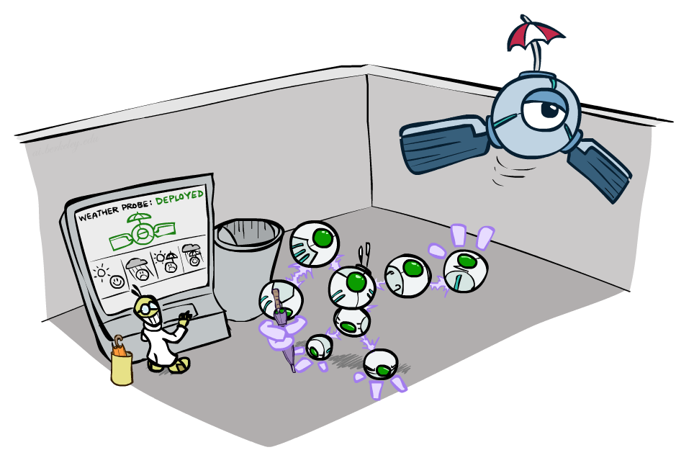
CS 188: Artificial Intelligence
Decision Networks and Value of Information
Spring 2023
University of California, Berkeley
[These slides were created by Dan Klein and Pieter Abbeel for CS188 Intro to AI at UC Berkeley. All CS188 materials are available at http://ai.berkeley.edu.]
Notes:
Please retain proper attribution, including the reference to ai.berkeley.edu. Thanks!

Slide 2
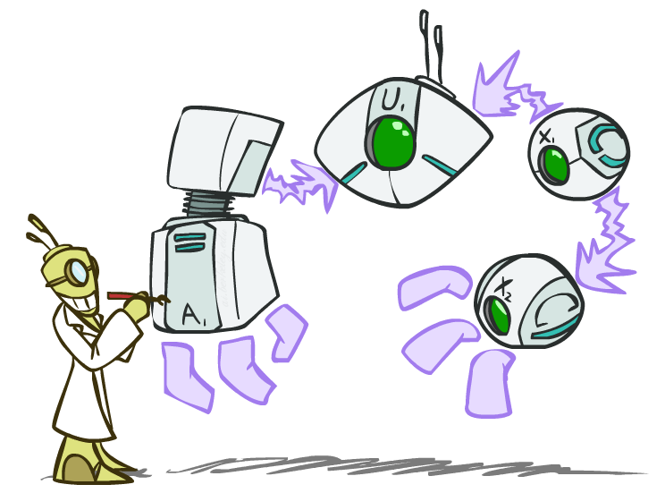
Decision Networks

Slide 3

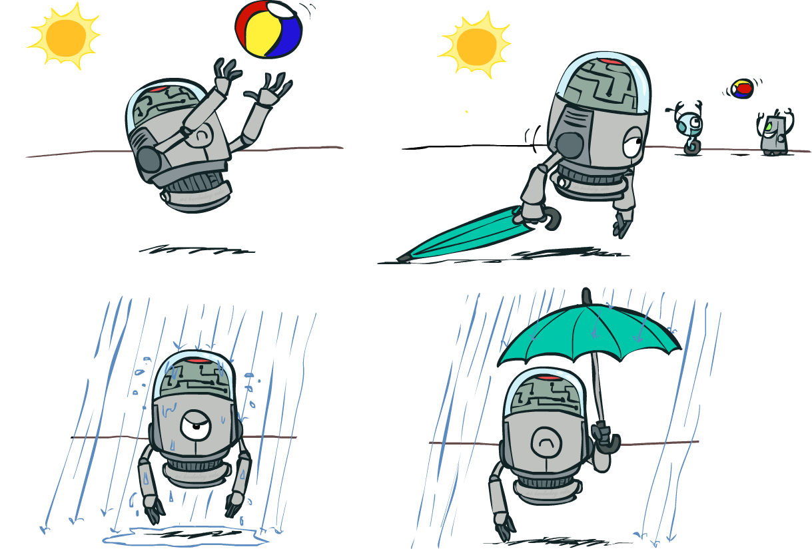

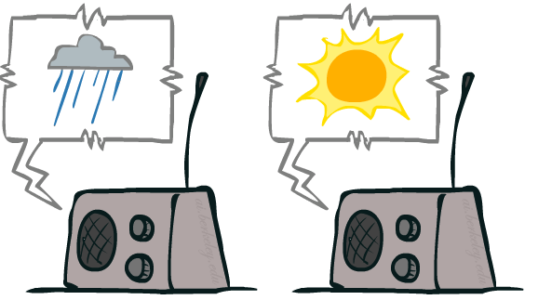
Decision Networks
Umbrella
U
Weather
Forecast
Notes:
There exists a ghostbusters demo

Slide 4
Decision Networks
MEU: choose the action which maximizes the expected utility given the evidence
Can directly operationalize this with decision networks
Bayes nets with nodes for utility and actions
Lets us calculate the expected utility for each action
New node types:
Chance nodes (just like BNs)
Actions (rectangles, cannot have parents, act as observed evidence)
Utility node (diamond, depends on action and chance nodes)
Umbrella
U
Weather
Forecast
Notes:
There exists a ghostbusters demo

Slide 5
Decision Networks
Action selection
Instantiate all evidence
Set action node(s) each possible way
Calculate posterior for all parents of utility node, given the evidence
Calculate expected utility for each action
Choose maximizing action
Umbrella
U
Weather
Forecast
Notes:
There exists a ghostbusters demo

Slide 6
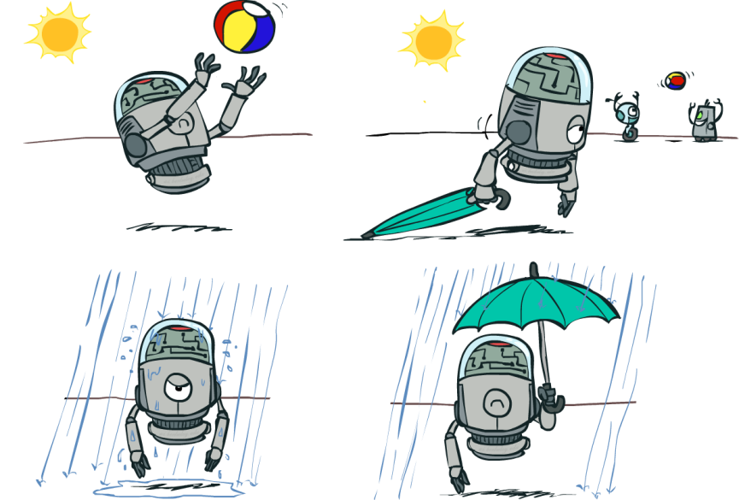
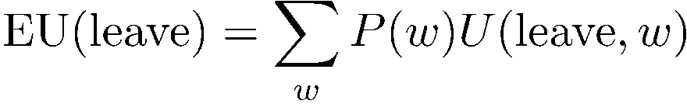
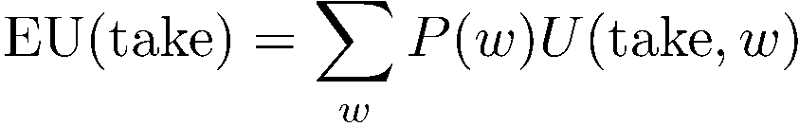
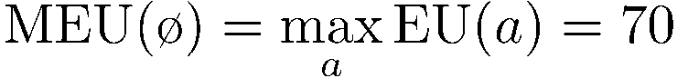
Decision Networks
Umbrella = leave
Umbrella
U
Umbrella = take
Weather
A | W | U(A,W)
leave | sun | 100
leave | rain | 0
take | sun | 20
take | rain | 70
W | P(W)
sun | 0.7
rain | 0.3
Optimal decision = leave
Notes:
There exists a ghostbusters demo

Slide 7
Decision Networks: Notation
Umbrella = leave
EU(leave) = Expected Utility of taking action leave
In the parentheses, we write an action
Calculating EU requires taking an expectation over chance node outcomes
MEU(ø) = Maximum Expected Utility, given no information
In the parentheses, we write the evidence (which nodes we know)
Calculating MEU requires taking a maximum over several expectations (one EU per action)
Umbrella = take
Optimal decision = leave
Notes:
There exists a ghostbusters demo

Slide 8
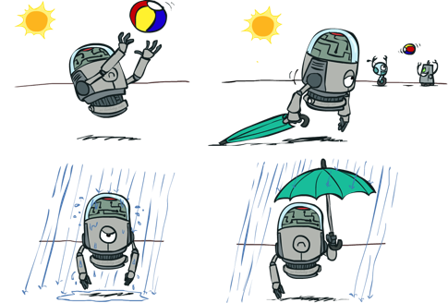

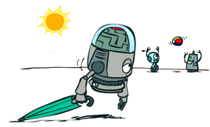


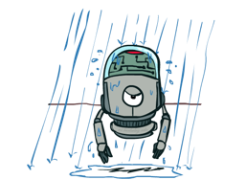
Decisions as Outcome Trees
{}
take
leave
Umbrella
Weather | {}
Weather | {}
U
sun
sun
Weather
rain
rain
U(t,s)
U(t,r)
U(l,s)
U(l,r)
Almost exactly like expectimax / MDPs
What’s changed?

Slide 9
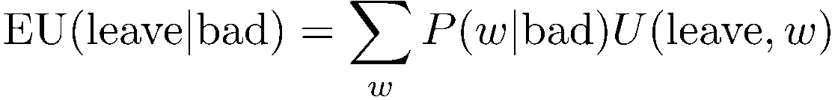


Example: Decision Networks
Umbrella = leave
A | W | U(A,W)
leave | sun | 100
leave | rain | 0
take | sun | 20
take | rain | 70
Umbrella
U
Umbrella = take
Weather
W | P(W|F=bad)
sun | 0.34
rain | 0.66
Optimal decision = take
Forecast
=bad

Slide 10
Decision Networks: Notation
EU(leave|bad) = Expected Utility of taking action leave, given you know the forecast is bad
Left side of conditioning bar: Action being taken
Right side of conditioning bar: The random variable(s) we know the value of (evidence)
MEU(F=bad) = Maximum Expected Utility, given you know the forecast is bad
In the parentheses, we write the evidence (which nodes we know)
Umbrella = leave
Umbrella = take
Optimal decision = take
Notes:
There exists a ghostbusters demo

Slide 11

Decisions as Outcome Trees
Umbrella
{b}
take
leave
U
W | {b}
W | {b}
Weather
sun
sun
rain
rain
U(t,s)
U(t,r)
U(l,s)
U(l,r)
Forecast
=bad

Slide 12
Ghostbusters Decision Network
Demo: Ghostbusters with probability
Bust
U
Ghost Location
…
Sensor (1,1)
Sensor (1,2)
Sensor (1,3)
Sensor (1,n)
Sensor (2,1)
…
…
…
Sensor (m,1)
Sensor (m,n)

Slide 13

Video of Demo Ghostbusters with Probability

Slide 14
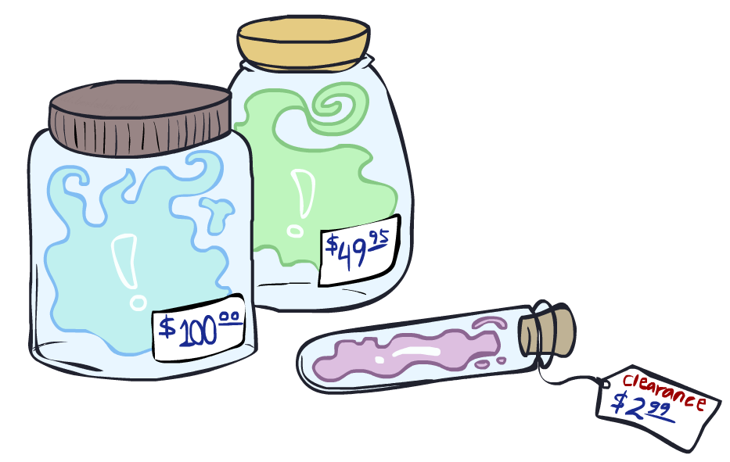
Value of Information

Slide 15
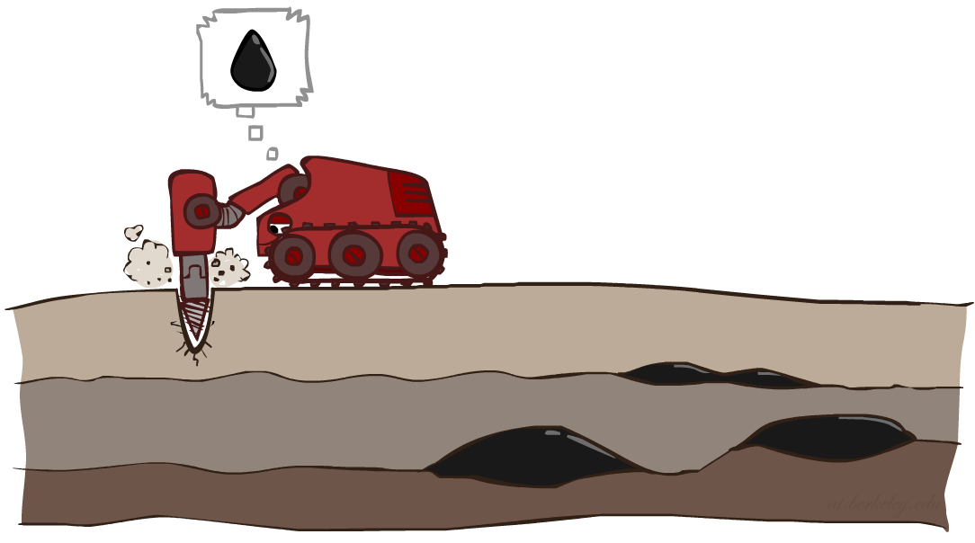
Value of Information
Idea: compute value of acquiring evidence
Can be done directly from decision network
Example: buying oil drilling rights
Two blocks A and B, exactly one has oil, worth k
You can drill in one location
Prior probabilities 0.5 each, & mutually exclusive
Drilling in either A or B has EU = k/2, MEU = k/2
Question: what’s the value of information of O?
Value of knowing which of A or B has oil
Value is expected gain in MEU from new info
Survey may say “oil in a” or “oil in b”, prob 0.5 each
If we know OilLoc, MEU is k (either way)
Gain in MEU from knowing OilLoc?
VPI(OilLoc) = k/2
Fair price of information: k/2
D | O | U
a | a | k
a | b | 0
b | a | 0
b | b | k
DrillLoc
U
O | P
a | 1/2
b | 1/2
OilLoc

Slide 16
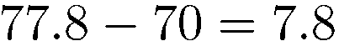
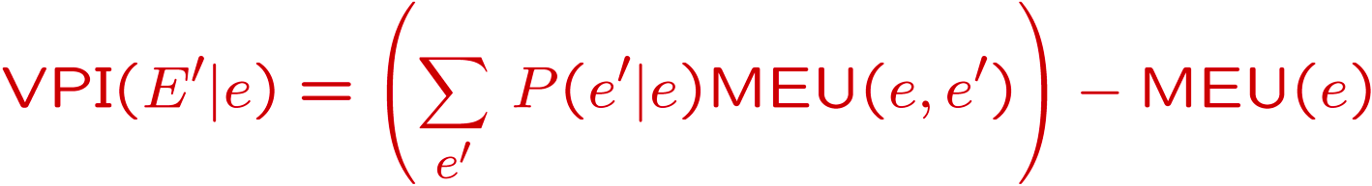
VPI Example: Weather
MEU with no evidence
Umbrella
A | W | U
leave | sun | 100
leave | rain | 0
take | sun | 20
take | rain | 70
U
MEU if forecast is bad
Weather
MEU if forecast is good
Forecast
Forecast distribution
F | P(F)
good | 0.59
bad | 0.41

Slide 17
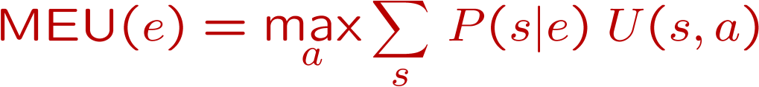
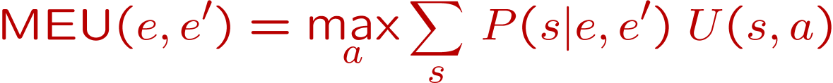
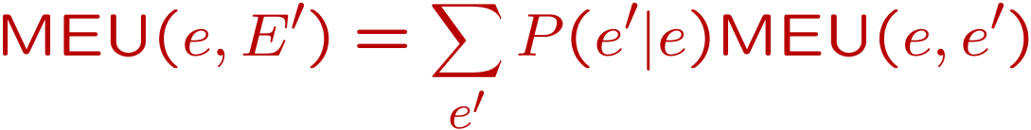
Value of Information
{+e}
Assume we have evidence E=e. Value if we act now:
Assume we see that E’ = e’. Value if we act then:
BUT E’ is a random variable whose value is
unknown, so we don’t know what e’ will be
Expected value if E’ is revealed and then we act:
Value of information: how much MEU goes up
by revealing E’ first then acting, over acting now:
a
P(s | +e)
U
{+e, +e’}
a
P(s | +e, +e’)
U
{+e}
P(+e’ | +e)
P(-e’ | +e)
{+e, +e’}
{+e, -e’}
a

Slide 18
VPI: Notation
MEU(e) = Maximum Expected Utility, given evidence E=e
In the parentheses, we write the evidence (which nodes we know)
Calculating MEU requires taking a maximum over several expectations (one EU per action)
VPI(E'|e) = Expected gain in utility for knowing the value of E', given that I know the value of e so far
Left side of conditioning bar: The random variable(s) we want to know the value of revealing
Right side of conditioning bar: The random variable(s) we already know the value of
Calculating VPI requires taking an expectation over several MEUs (one MEU per possible outcome of E', because we don’t know the value of E')

Slide 19
VPI: Computation Workflow

Slide 20
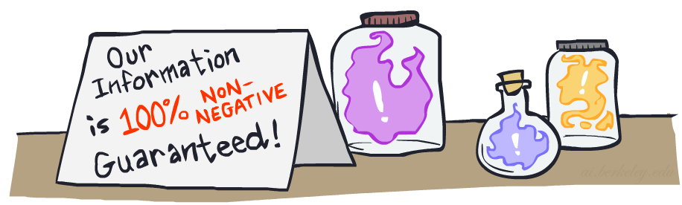
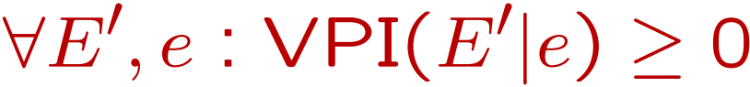
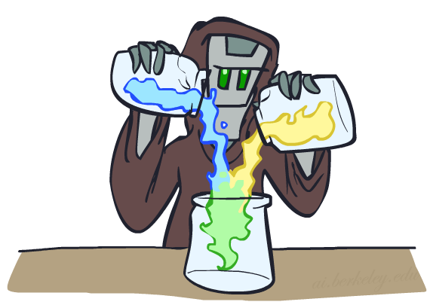
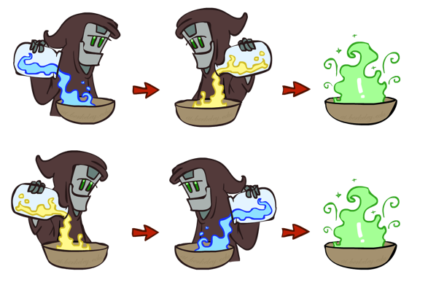
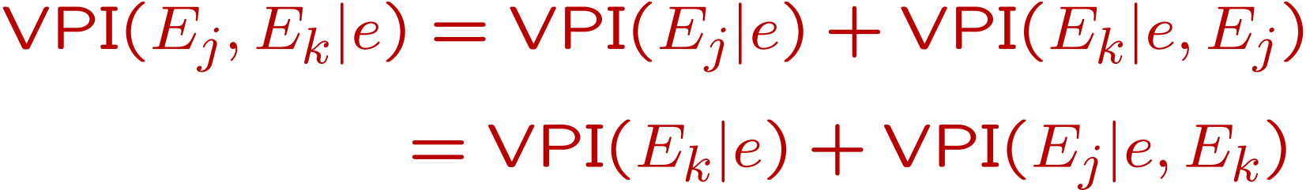
VPI Properties
Nonnegative
Nonadditive
(think of observing E_{j} twice)
Order-independent

Slide 21
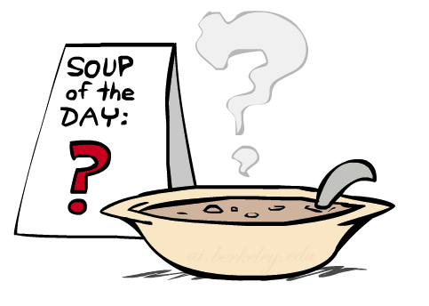
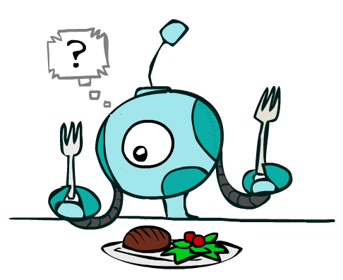
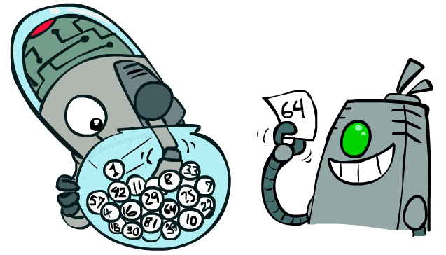
Quick VPI Questions
The soup of the day is either clam chowder or split pea, but you wouldn’t order either one. What’s the value of knowing which it is?
There are two kinds of plastic forks at a picnic. One kind is slightly sturdier. What’s the value of knowing which?
You’re playing the lottery. The prize will be $0 or $100. You can play any number between 1 and 100 (chance of winning is 1%). What is the value of knowing the winning number?

Slide 22
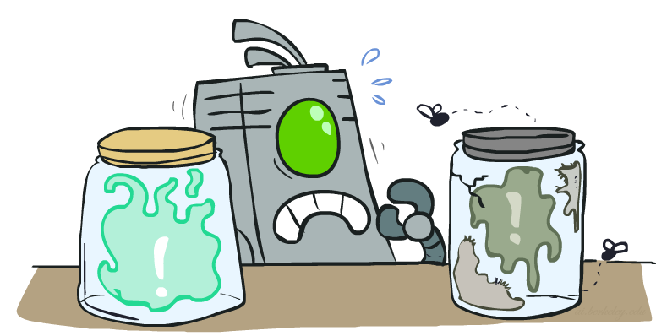
Value of Imperfect Information?
No such thing (as we formulate it)
Information corresponds to the observation of a node in the decision network
If data is “noisy” that just means we don’t observe the original variable, but another variable which is a noisy version of the original one

Slide 23
VPI Question
VPI(OilLoc) ?
VPI(ScoutingReport) ?
VPI(Weather) ?
VPI(Weather | ScoutingReport) ?
Generally:
If Parents(U) Z | CurrentEvidence
Then VPI( Z | CurrentEvidence) = 0
DrillLoc
U
Weather
OilLoc
Scouting
Report

Slide 24
Next Time: Dynamic Models

